Slide 1
Churn Analytics
MTA Customers Feedback Analysis

Slide 2
Problem Statement:
This industry has a unique set of challenges from the technology front and the customer demands due to its wide range of sectors. The Telecom industry consists of a set of sectors like wireless communication, satellite communication, Internet Service providers etc. The primary objective is on the churn in telecom industries to accurately estimate the customer survival and customer hazard functions to gain the complete knowledge of churn over the customer tenure.

Slide 3
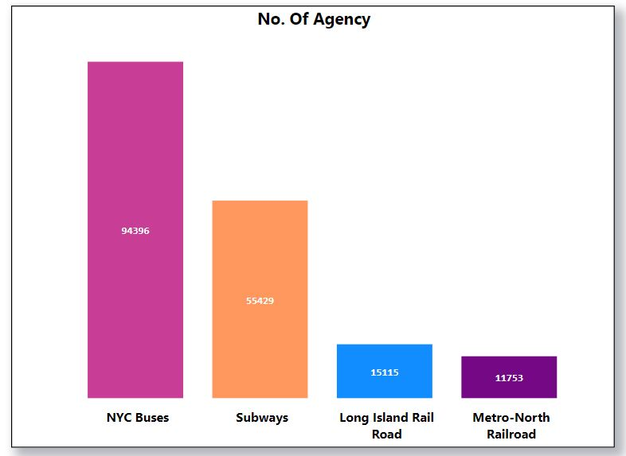
No. Of Agency

Slide 4
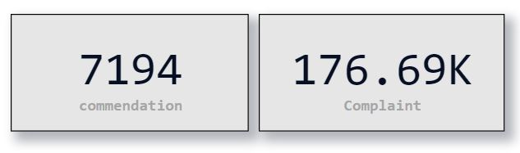
Commendation or Complaint

Slide 5
